Slide 1
Intro to Python
Modules

Slide 2

Modules
We have already seen some modules such as re, random, pathlib etc.
Higher level structural building block which can contain, variables, classes, functions and statements
All .py files are modules, the name of a module is the name omitting the .py extension
As we know the import keyword is used to bring the functionality of an external module to your own code

Slide 3
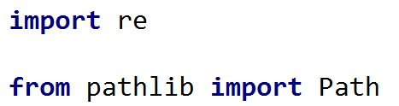
Importing Modules
Module themselves define a namespace and by importing a module, the user gains access to the name space
You may either import using the from or import keywords:
Import multiple modules on the same line is possible as well:

Slide 4
Import vs from … import
Simply using import keyword alone imports the module as a single object in your name space:
Whereas from … import imports individual names from the module into the current namespace:

Slide 5


from … import *
from … import * will import all available names into your current name space, for example:
from modifies import to allow to import specific names from within an external module.

Slide 6
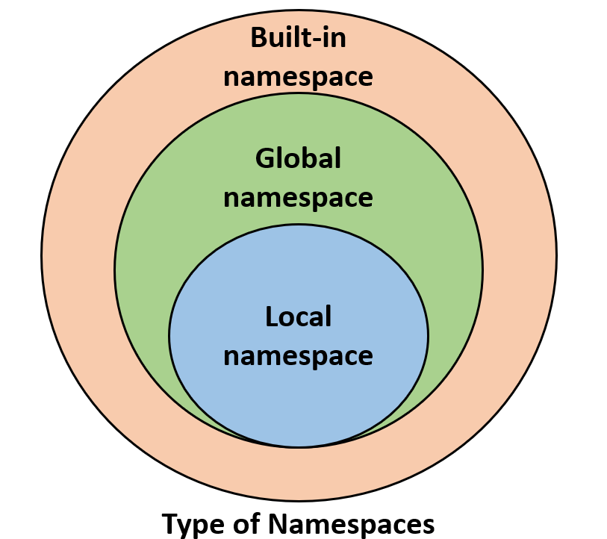
Name spaces visualised

Slide 7

from … import … as
The main reason for the word from is to remove the need to have many references to a module
Its best used when a module has many names/sub-modules and you only actually need one of them and there is no point of importing the whole module
The as keyword allows to create an alternative name (or alias) for an imported name:
The keyword as allows you to import some module and refer to it as another name

Slide 8

Importing Modules
Whenever an import statement is written, Python will look through a list of directories to find it
This list can be expected via the sys module:
Output:

Slide 9
Packages
Larger libraries are sometimes referred to as packages which is essentially a bundle of modules together in a directory:
Here is an example of importing the sounds package but as well exploring sub packages such as effects which are nested inside of this package.
This means that somewhere in the Python Path there is a directory called sounds, and under this there is another directory called effects which contains various Python modules, one of which is called noise, notice how the “.” is used as a directory separator.

Slide 10
Modules – Exercise 1
Create a file called coin_toss_module.py containing the coin_toss function we did a some classes ago, sample code attached in zip folder (coin_toss.py)
Then create a new file called coin_toss_test.py
Call the coin_toss function from within the coin_toss_test.py file.

Slide 11
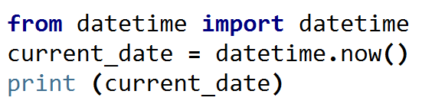
Date & time module
The datetime module supplies some classes for extracting the current date and time (datetime.py), for example:
The above will print the current date and time with exact precision.
Read more on the datetime module here

Slide 12
Installing External Modules
So far we have seen that modules are powerful and that there are variety of them that allows to harness and enhance the full power of Python.
The most common external modules were pre-installed with Python, but what happens when we deal with a module that is not already installed?
So lets learn how to install external modules!

Slide 13
Python Package Managers - PIP
Python package managers make the job much easier to install external modules
PIP is the most common package manager system for Python and can install modules by using one command
There are modules that can solve all kinds of problems
Biopython: contains various tools for bioinformatics
Pandas: module for data manipulation and analysis
Tensorflow: machine learning library focusing on deep learning and neural nets.

Slide 14
PIP
PIP allows easy installation of external packages outside of Python with one command
To get and install PIP follow the instructions here
Basic use of PIP: pip install some_package
If you have permission issues try: sudo pip install some_package
And to uninstall packages: pip uninstall some_package
It should be installed by default but if not check the link above to install

Slide 15
Numpy
Numpy is an external Python package that make it easy to perform operations on a collection of numbers
Numpy allows for easy use of data manipulation with matrices and linear algebra
Much faster than using loops traditionally in Python
Whenever dealing with a list of numbers, then consider using numpy

Slide 16
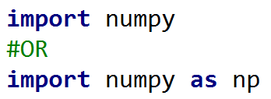
Numpy - importing
Numpy is commonly imported by the following commands:

Slide 17

Numpy - arrays
Numpy is known for its numpy array, when wanting to create an array from a list or tuple:
When comparing to lists, numpy arrays are designed to contain elements of the same type and can be specified explicitly:
Other types can be used as well np.int, np.float etc. and if not specified numpy will try to guess the type.

Slide 18





Numpy - Arrays
There are a multitude ways of initializing numpy arrays:
For range of numbers:
➔
Zero’s:
➔
One’s:
➔

Slide 19
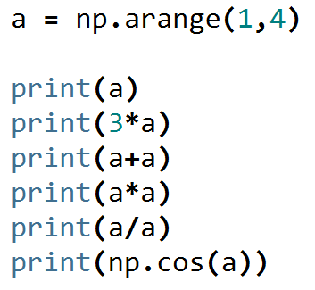
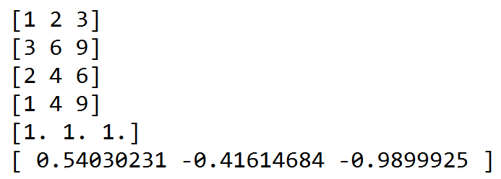
Numpy Array Operations
The same common operators we have seen are available with numpy:
Output:
Note how it automatically applied to each element

Slide 20




Numpy – Random Arrays
You can create arrays with random numbers
Random floating point numbers are between 0 and 1 as we have seen in the past:
Printing random integers:

Slide 21
Numpy – Exercise 2
Create a program that is one line of code that calculates the average of 10,000 throws of the sum of 2 dice
HINT: Use np.average() to calculate the average over an array

